Slide 1

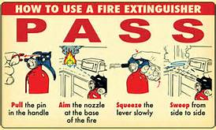
Using a Portable Fire Extinguisher Utilizing the PASS Method

Slide 2





Types of Fires
Class A – Class A – Ordinary combustibles such as wood, paper, plastic, rubber and cloth
Class B – Flammable and combustible liquids and gases
Class C – Electrical fires (in electrical equipment)
Class D – Combustible metals
Class K – Cooking oils (commercial kitchens)

Slide 3
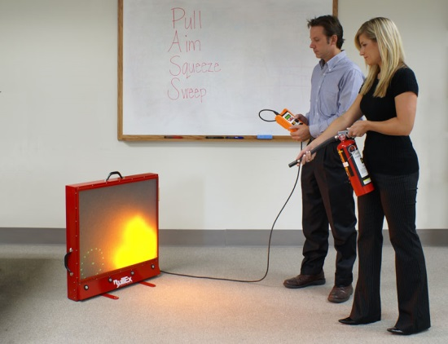
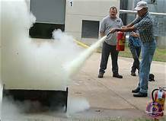
Safety Rules
Use an extinguishers ONLY if you have been trained to uses it.
Fire Extinguishers are for SMALL FIRES in the early stages
Know where you extinguishers are located

Slide 4
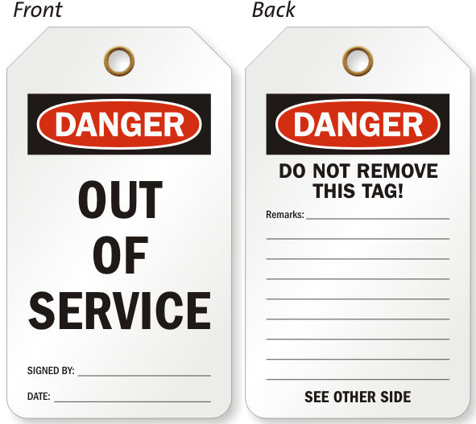
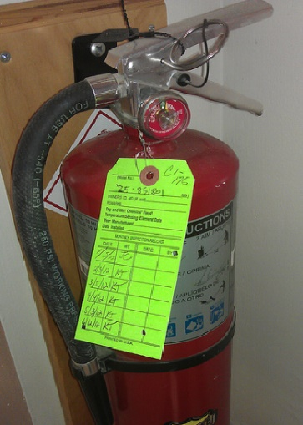
Safety Rules cont.
Do not put extinguishers in an upright position unless you are holding it
All fire extinguishers should have an inspection tag and trigger seal and a pin
After use Do Not place back into serviced until it has been refilled.

Slide 5
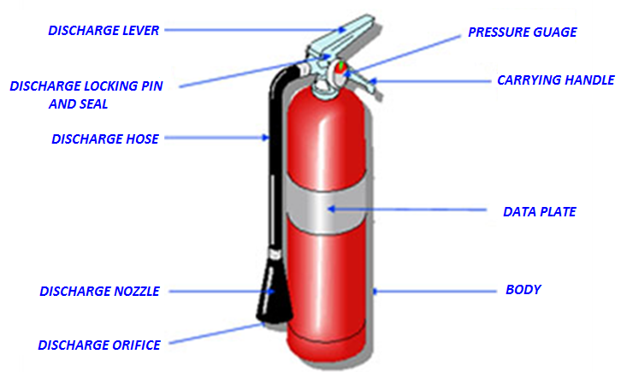
Fire Extinguisher Anatomy

Slide 6
Extinguishing a Fire with an Extinguisher
Proper Position
Locate the fire
Stand 6 to 8 feet away from fire
Stand in an upright position holding the extinguisher firmly with both hands

Slide 7
Extinguishing a Fire with
PASS Method
Pull the Pin – Pull the pin breaking the thin wire or plastic seal
Aim the nozzle – Aim the nozzle or hose towards the base of the fire
Squeeze the handle – Squeeze the handle together to release the agent
Sweep the nozzle – Sweep the nozzle back and forth to cover the burning material

Slide 8
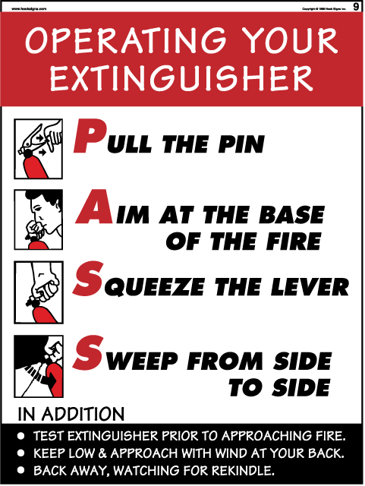
Extinguishing a Fire with
PASS Method

Slide 9
Using a Portable Fire Extinguisher Utilizing the PASS Method
Any Questions?

